Slide 1
Space Egg
Olivia G 301974

Slide 2
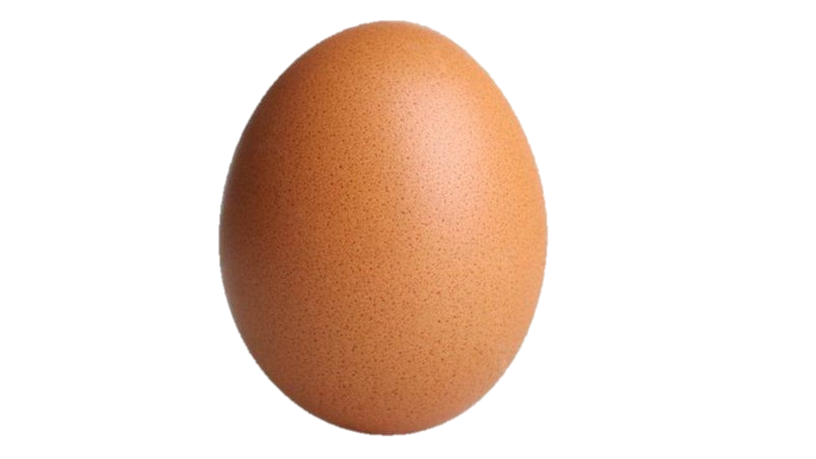
Story
You are a gravitational platform in space with an egg that has landed on your off putting your balance.
Try to keep yourself and this egg from falling off into the abyss.

Slide 3

Incorporation of the Concept/Mechanic
You are balancing yourself on a point beneath you

Slide 4
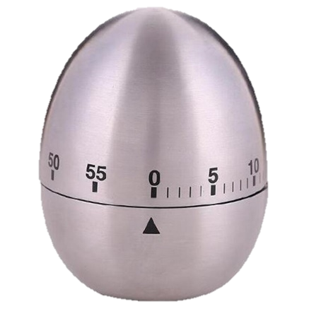
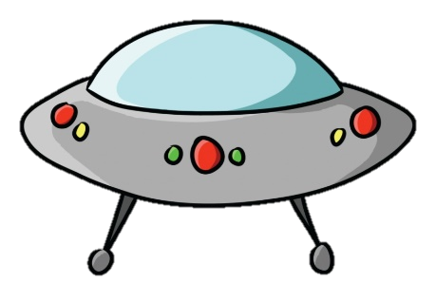
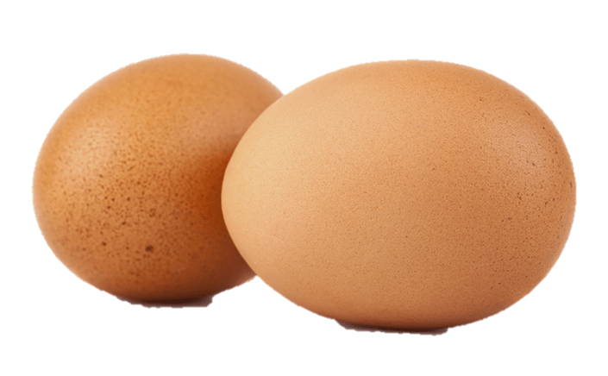
Additional Mechanics
- Timer
- High score tracker
- Potential challenges (additional eggs and offsetting objects)

Slide 5
Controls
You use the keys WASD to keep you and the egg steady
WASD
Center

